Slide 1
SECURE CODING
Unit I - INTRODUCTION

Slide 2
SECURITY
Security generally refers to the state of being free from danger or threat.
Types:
Network Security
Information Security
Endpoint Security
Application Security
Physical Security
Wireless Security
Internet Security

Slide 3
What is Secure Coding?
Secure coding is the practice of writing software with security in mind, aiming to prevent vulnerabilities and minimize the risk of cyberattacks.
Why is it important?
It will reduce vulnerabilities and protect data.

Slide 4

CIA Triad
CONFIDENTIALITY: Confidentiality ensures that information is accessible only to authorized individuals or entities. Encryption, access controls, and data classification are common methods used to enforce confidentiality.
INTEGRITY: Integrity ensures the accuracy, consistency, and trustworthiness of data and systems. It focuses on protecting data from unauthorized modification, deletion, or corruption. Techniques such as data validation, checksums, and digital signatures are used to maintain data integrity.

Slide 5
CIA Triad
AVAILABILITY: Availability ensures that authorized users have timely access to the information and resources they need. It involves preventing disruptions, system failures, or denial-of-service (DoS) attacks that could render systems or data inaccessible.

Slide 6
VIRUS:
A virus is a piece of self-replicating code that attaches itself to legitimate programs or files. It executes only when the infected host is run, and often causes corruption or destruction of data.
Types of Viruses:
File Infector Virus
Macro Virus
Boot Sector Virus
Polymorphic Virus

Slide 7
WORM:
A worm is a standalone malware that self-replicates and spreads automatically, usually over a network, without user interaction.
Examples: One famous example is the "ILOVEYOU" worm from the year 2000. It spread through email with the subject line "ILOVEYOU." When people opened the attached file, the worm sent itself to all their email contacts, spreading rapidly and causing significant damage by overwriting files on infected computers.

Slide 8
Trojan Horse (Trojan):
A Trojan is malware disguised as legitimate software. It does not self-replicate, but it tricks users into installing it. Typically spread via phishing, fake downloads, or malicious attachments.
Types of Trojans:
Banking Trojans – steal credentials.
Downloader Trojans – download other malware after installation.

Slide 9
SECURITY CONCEPTS:
1. Vulnerability: A vulnerability is a weakness or flaw in a system or application that can be exploited to compromise confidentiality, integrity, or availability.
2. Threat: A threat is any potential danger that may exploit a vulnerability to harm the system.
Types:
Spoofing identity
Information disclosure
Denial of service
Elevation of privilege

Slide 10
SECURITY CONCEPTS:
3. Attack: An attack is the actual action taken to exploit a vulnerability.
Types:
Active Attack: Modifies or damages data/systems.
Passive Attack: Eavesdrops on communication without altering it.
4. Exploit: An exploit is a piece of code, technique, or script that takes advantage of a vulnerability to perform an attack. The trick or path used to attack.
5. Risk: Risk is the potential impact of a threat exploiting a vulnerability.

Slide 11
MALWARE TERMINOLOGY
Malware is malicious software and refers to any software that is designed to cause harm to computer systems, networks, or users.
Rootkits: A rootkit is a type of malware designed to hide its presence and give attackers full control of a system at the root (admin) level. It modifies system files, drivers, or the kernel to stay hidden and run silently.
2. Trapdoors (Backdoors): A trapdoor or backdoor is a hidden method of bypassing normal authentication to access a system.

Slide 12
MALWARE TERMINOLOGY
3. Botnets: A botnet is a network of infected devices (bots or zombies) controlled remotely by an attacker, called a botmaster.
Malware infects a computer → joins the botnet → waits for commands.
4. Keyloggers: A keylogger is malware that records keystrokes typed by the user, capturing sensitive information like Passwords, Bank account numbers, and Personal messages.
5. Honeypots: A honeypot is not malware — it’s a security tool used by defenders.

Slide 13
ACTIVE VS PASSIVE SECURITY ATTACKS
Active Security Attacks: In an active attack, the attacker modifies, disrupts, or damages the system or data. The attacker acts and causes change or damage.
Examples: DoS attack, Man-in-the-Middle (MitM), Malware injection.
Passive Security Attacks: In a passive attack, the attacker only observes or listens to communications or data without modifying anything.
Examples: Eavesdropping, Traffic analysis.

Slide 14
IP SPOOFING
In IP spoofing, an attacker manipulates the source IP address in the packet header to make it appear as if it’s coming from a trusted source.
This tricks the target into accepting the packets, thinking they are from a legitimate sender.
The attacker can then bypass access controls, authentication mechanisms, or even redirect traffic to unintended destinations.

Slide 15
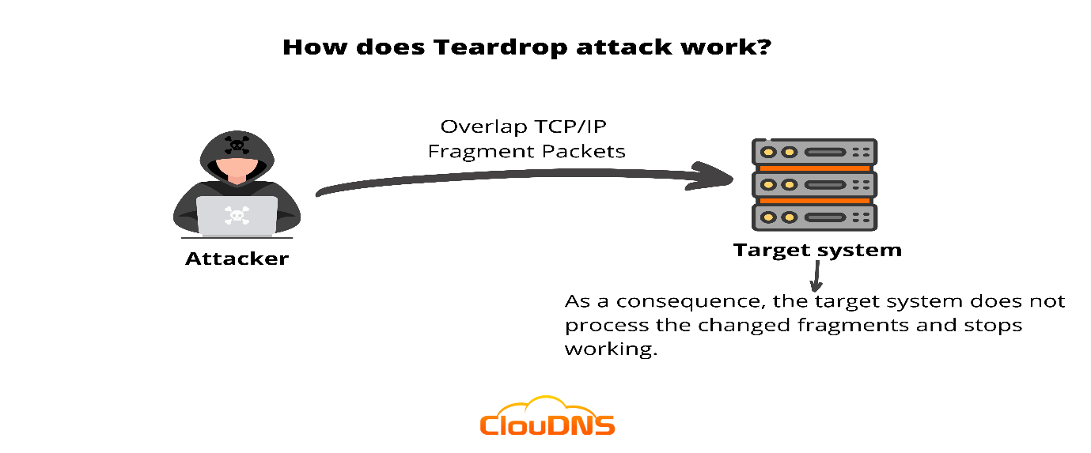
TEARDROP ATTACK

Slide 16
DDOS ATTACK:
A distributed denial-of-service (DDoS) attack is a malicious attempt to disrupt the normal traffic of a targeted server, service or network by overwhelming the target or its surrounding infrastructure with a flood of Internet traffic.

Slide 17
CROSS-SITE SCRIPTING (XSS)
Cross-Site Scripting (XSS) is a web security vulnerability that allows attackers to inject malicious scripts into web pages viewed by other users. This type of attack can compromise the interactions users have with a vulnerable application, allowing attackers to masquerade as users, access their data, and perform actions on their behalf.
Types of Cross-Site Scripting:
Stored XSS
Reflected XSS

Slide 18
SQL INJECTION:
An SQL injection attack consists of an insertion or injection of a SQL query via the input data from the client to the application.
Example: login form where a user enters a username and password: SELECT * FROM users WHERE username = 'user' AND password = 'password';
If the attacker inputs admin’-- , it would be:
SELECT * FROM users WHERE username = ‘admin’ --‘ AND password=’password’;
http://localhost/vulnerable-sql/index.php?username=' OR '1'=‘1
http://localhost/vulnerable-sql/index.php?username=admin' -- &password=anything

Slide 19
ICMP FLOOD (SMURF ATTACK)
The ICMP flood, particularly known as a Smurf attack, involves sending a large number of ICMP echo requests (commonly known as "pings") to a network's broadcast address, with the spoofed source address set to the target’s IP.
The network devices then respond to these requests, overwhelming the target system with a flood of ICMP echo replies.
This massive volume of traffic can saturate the target’s network bandwidth, leading to a Denial of Service (DoS).

Slide 20
Man-in-the-Middle (MitM) Attacks
A MitM attack occurs when an attacker intercepts communication between two parties, often to eavesdrop or alter the communication.
A man-in-the-middle attack is a cyberattack in which the attacker can secretly intercept messages between two or more parties who believe they are communicating with each other.
Attackers can then use their position as the “man in the middle” to read this confidential information, even maliciously edit it, or insert their own messages.
This can lead to a devastating data breach or the spread of malware throughout an organization’s IT environment.

Slide 21
FORMAT STRING ATTACK
A Format String Attack occurs when user input is unsafely used in functions like printf() in C/C++.
Ex: printf(user_input); // INSECURE!
How to prevent? Always use format specifiers:
printf("%s", user_input); // SECURE

Slide 22
OVERFLOW ATTACKS
Overflow attacks, particularly buffer overflow attacks, occur when a program writes more data to a buffer (a temporary storage area in memory) than it is designed to hold.
This excess data can overflow into adjacent memory, potentially allowing attackers to manipulate the execution of the program.
These attacks exploit software vulnerabilities to execute arbitrary code or cause the program to crash.

Slide 23
RACE CONDITIONS:
A race condition happens when two tasks run at the same time, and the system can’t decide which finishes first, which causes unexpected results.
How an attacker might exploit this vulnerability:
The attacker initiates multiple login attempts simultaneously, exploiting the asynchronous nature of the system.
These login attempts are processed concurrently by the system, potentially leading to a race condition where the authentication process is not completed in the expected order.
By manipulating the timing or sequence of events, the attacker may attempt to bypass authentication checks or gain unauthorized access to user accounts.
If successful, the attacker gains access to user accounts, allowing them to steal sensitive data or perform malicious actions such as transferring funds to their accounts.

Slide 24
INVALIDATED INPUT
When a program does not check or clean the data it receives from the user, it’s called invalid input. Example: username = input("Enter your name: ")
query = f"SELECT * FROM users WHERE username = '{username}'"
print(query)
IF USER ENTERS: admin’ –
The final query becomes: SELECT * FROM users WHERE username = 'admin' -- '
The -- tells the system to ignore the rest, and the attacker logs in without a password.

Slide 25
ACCESS CONTROL PROBLEMS:
Vertical Privilege Escalation: A regular user gains admin-level access. Example: Customer service rep accessing the CEO's emails.
Horizontal Privilege Escalation: User accesses another user's data at the same privilege level. Example: One bank customer sees another customer's account
Broken Access Control: The System fails to enforce proper restrictions. Example: Changing URL parameters to access other users' data
Insecure Direct Object References (IDOR): Accessing objects directly by manipulating identifiers. Example: Changing "/user?id=123" to "/user?id=124"
Missing Function-Level Access Control: The Server doesn't verify permissions for functions. Example: "Delete account" button visible to all users.

Slide 26
1. Authentication Weaknesses:
Weak Password Policies
Allowing simple passwords (e.g., "password123")
Credential Management Issues
Storing passwords in plaintext
Improper hashing (using MD5 or SHA-1 instead of bcrypt/Argon2)
Authentication Bypass Vulnerabilities
"Remember me" functionality with weak tokens
Predictable session IDs
Missing multi-factor authentication (MFA) for sensitive operations
Account Recovery Flaws
Security questions with easily guessable answers
Email/SMS reset links that don't expire
No limit on login tries

Slide 27
Authorization Weaknesses:
Authorization weaknesses occur when systems fail to properly enforce what authenticated users are allowed to do.
Common Authorization Weaknesses:
No access control: Everyone can access everything
Insecure role handling: Users assign roles to themselves
Function-level access not protected: Hidden actions still work
Horizontal privilege escalation: User accesses others' data
Vertical privilege escalation: Regular user becomes admin

Slide 28
Weaknesses in Cryptographic Practices
Weak Algorithm Selection
Using deprecated algorithms (RC4, DES, MD5)
Insufficient key lengths (RSA < 2048 bits)
Key Management Issues
Keys stored with encrypted data
Transport Layer Issues
Supporting weak TLS versions (SSLv3, TLS 1.0)
Accepting NULL cipher suites
Certificate verification failures

